Slide 1
Example Roads
2/28/2014

Slide 2
I chose the example roads based on the following criteria:
To contain very complex shape Our focus is very complex patterns instead of the grid or radial shape. If we want to use rule-based approach for such a shape, we will have to write a rule for each road segment or each intersection, which is practically impossible. Or if we want to use tensor-based approach, we will have to draw many highperstreamlines with very complicated shapes, which is also impossible for the ordinary users.
To contain many intersections and road segments. If there are a few intersections, then it will be easy for other approaches to regenerate the similar roads.
To be away from highways, or at least not intersected with highways. Highways are out of our scope, so we do not want to deal with highways.
The elevation of the area should be mostly flat We do not consider the elevation at all, so we do not want to use an example in which the elevation change affected the shape of the roads.
To show some interesting patters which users want to use in their designing.

Slide 3
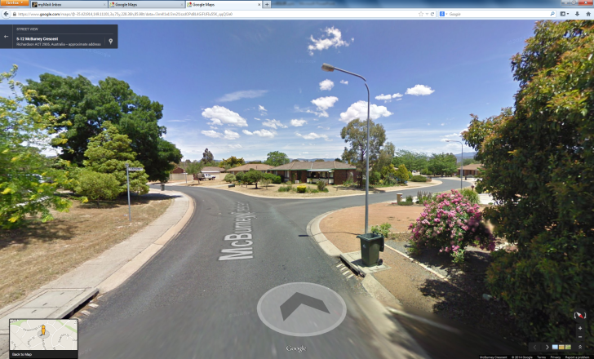
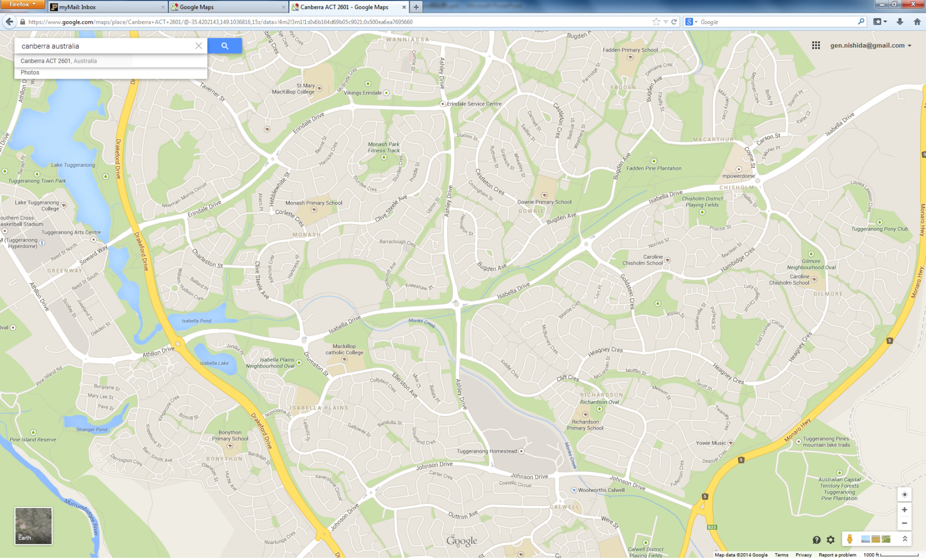
Southern area of Canberra:
Residential area, and contains very curvy roads.

Slide 4
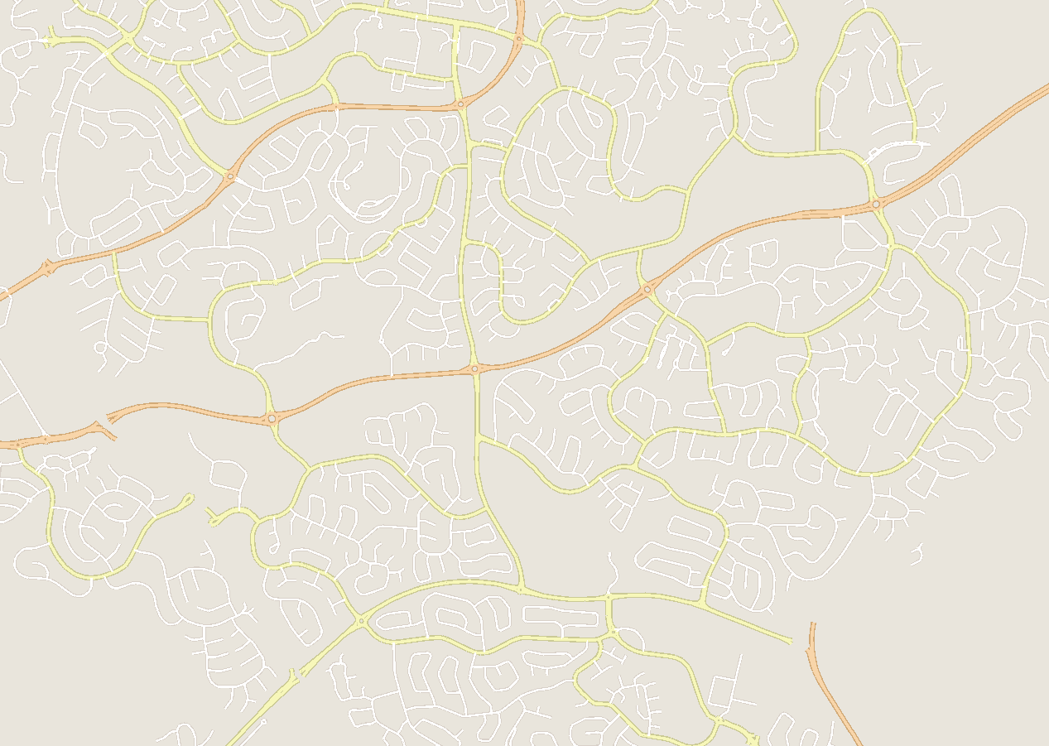
Avenues and local streets

Slide 5
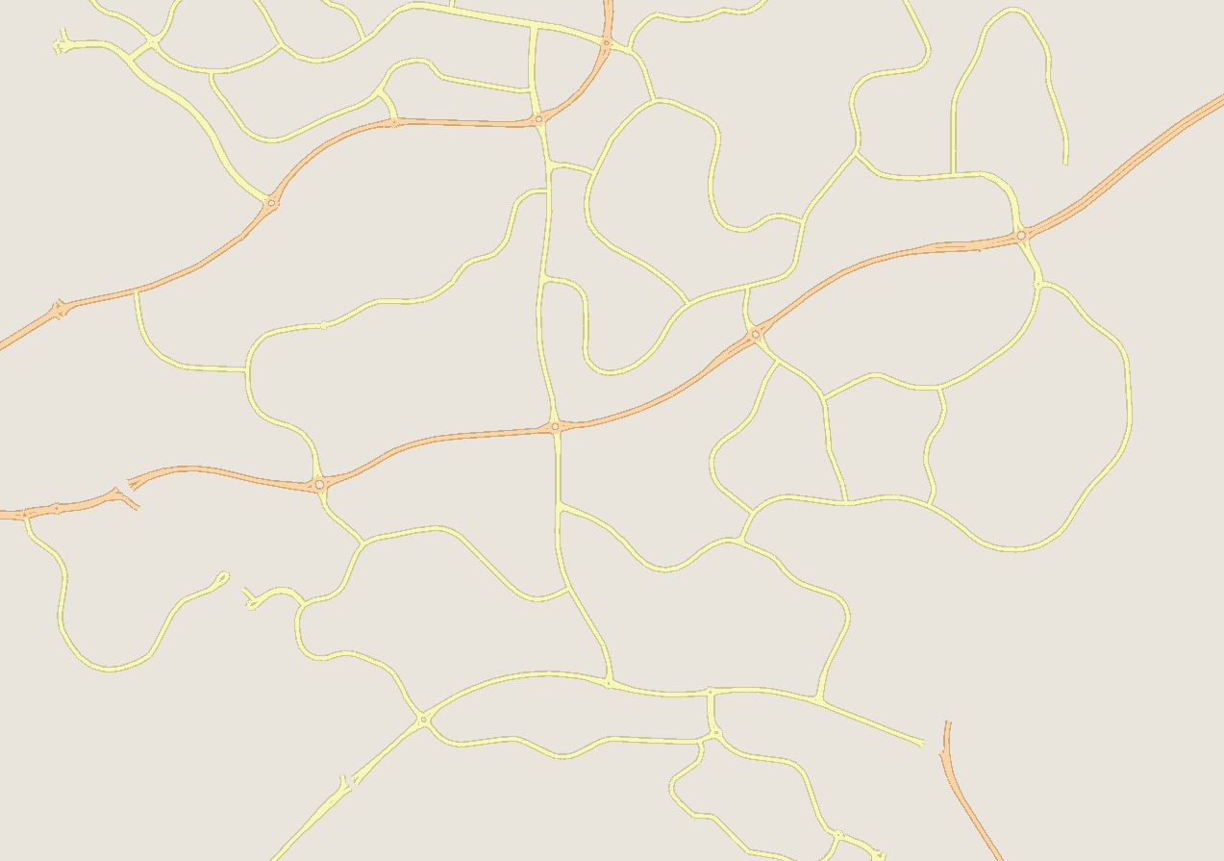
Avenues only

Slide 6
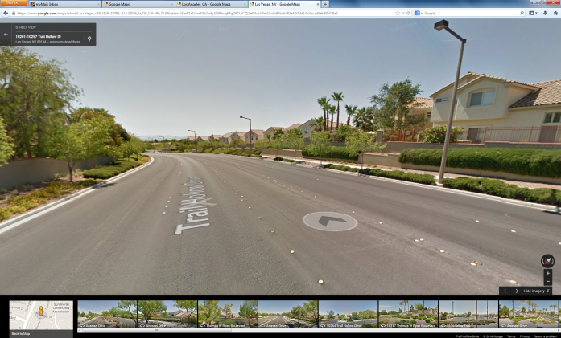
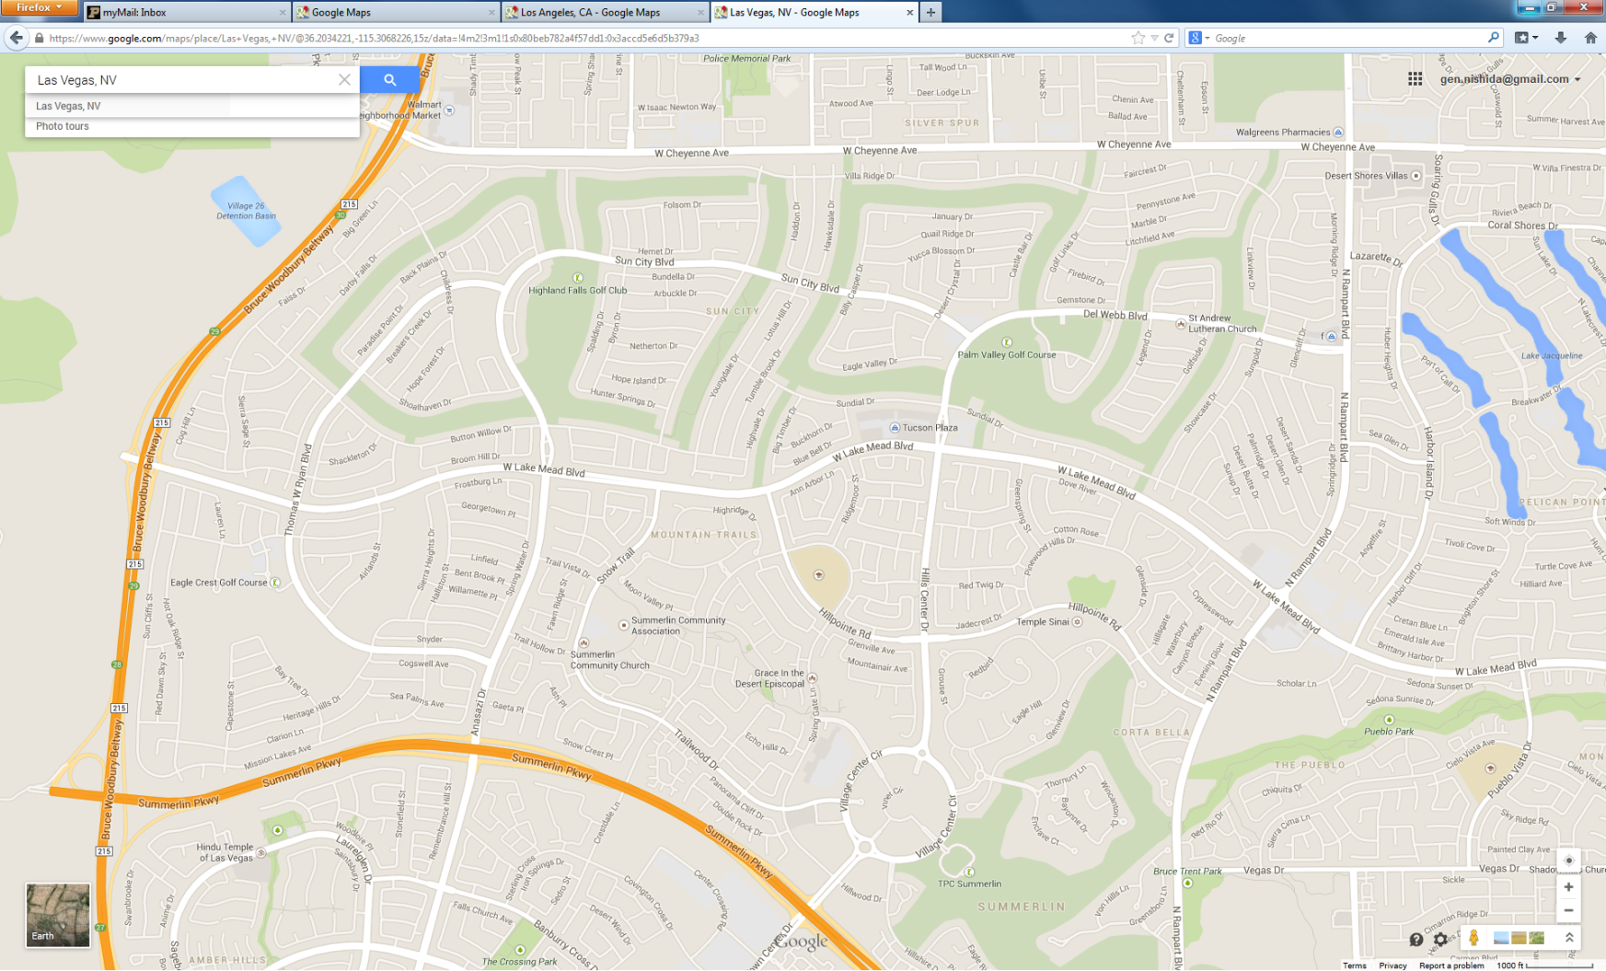
Northwest area of Las Vegas
Residential area, and contains very curvy roads.

Slide 7
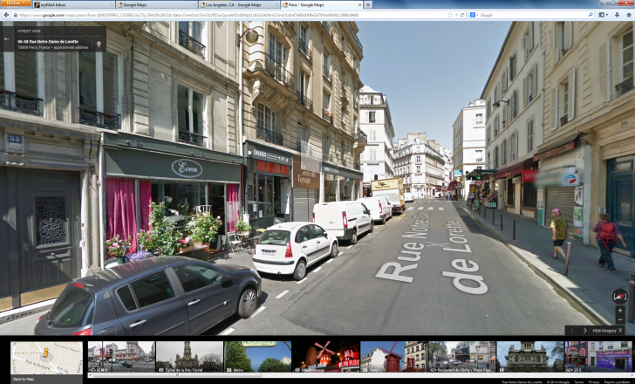
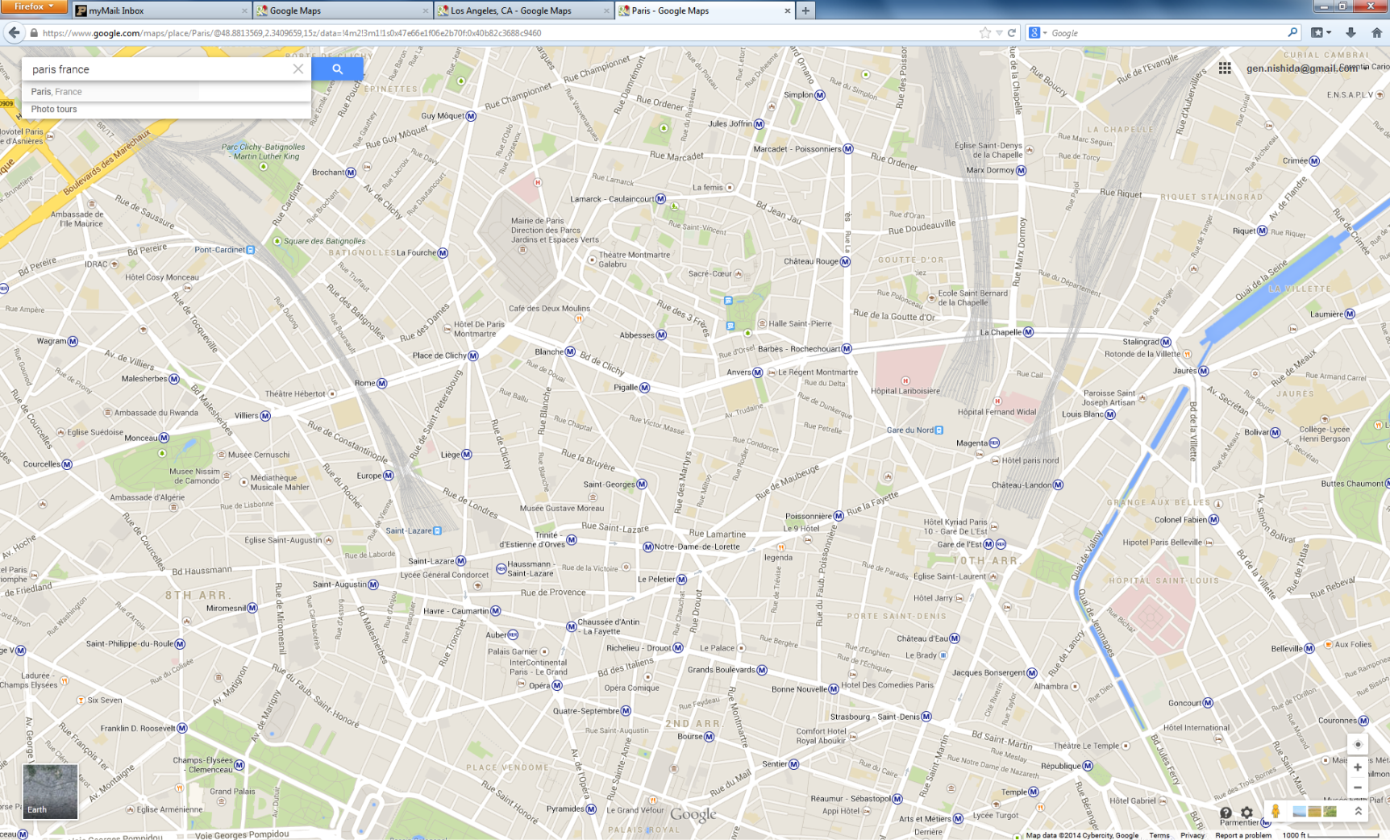
Paris
Composite of commercial and residential area. Most of the road segments form straight lines, but the direction looks stochastic.

Slide 8
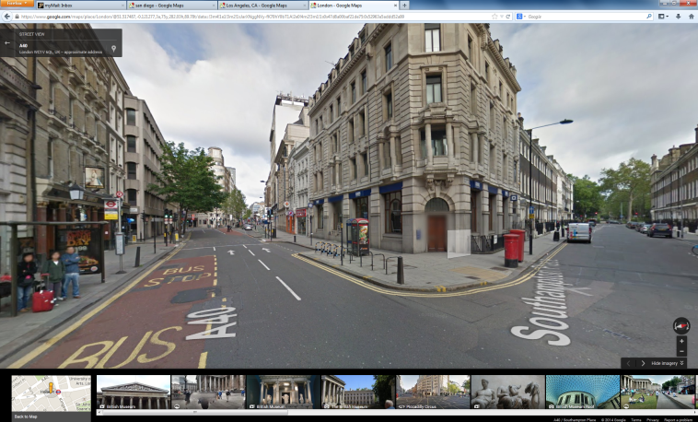
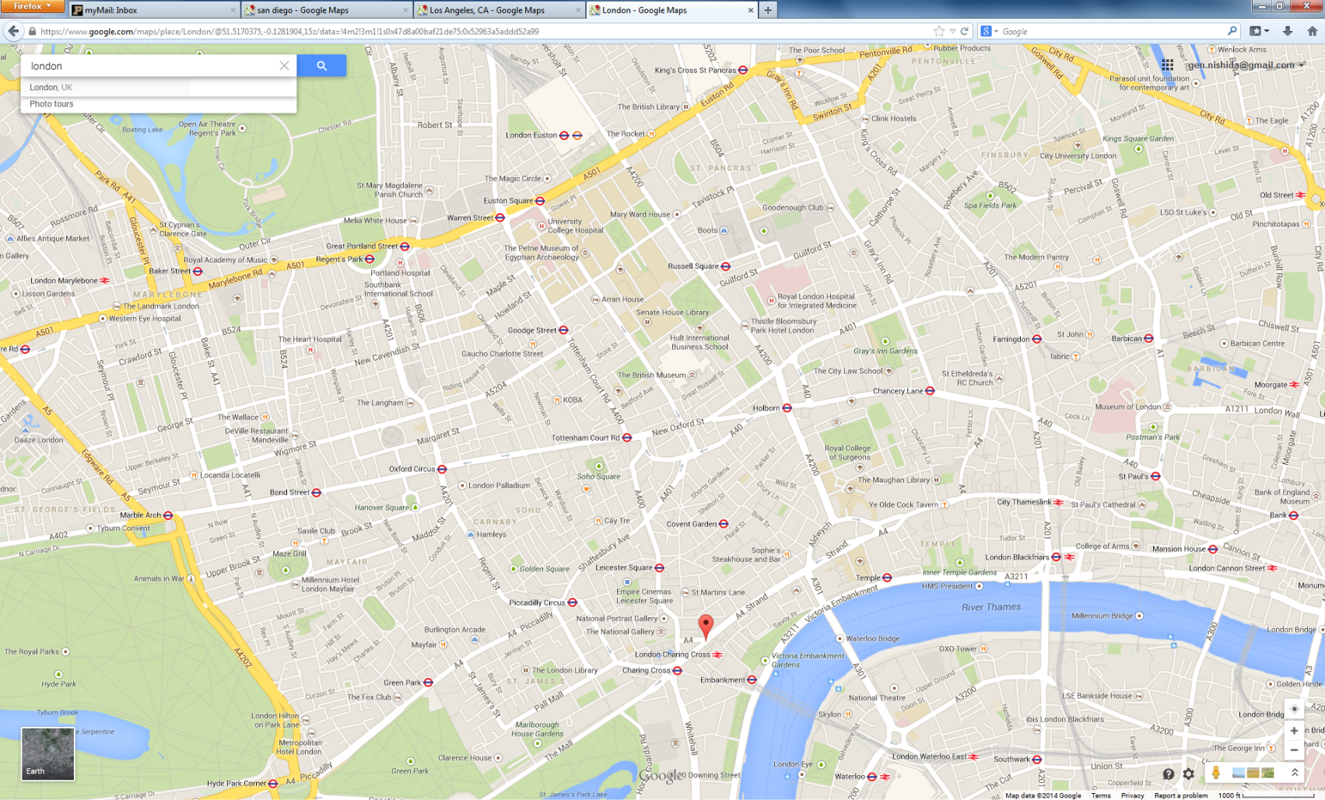
London
Composite of commercial and residential area. Most of the road segments form straight lines, and their directions are not so random, but are still hard to design.

Slide 9
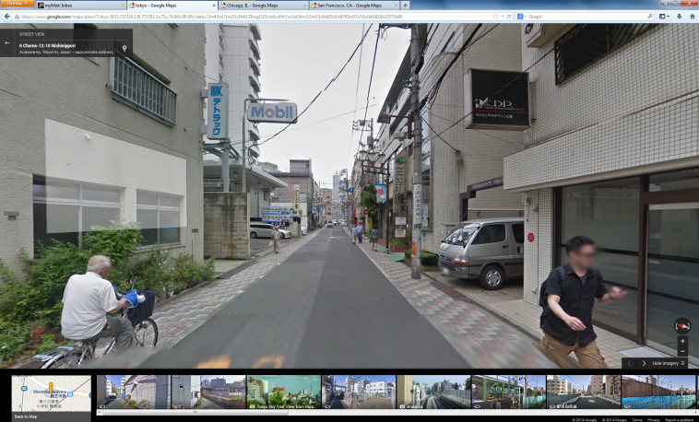
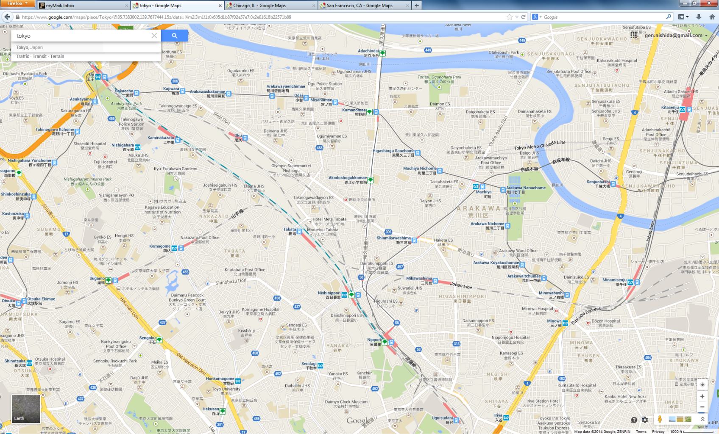
Tokyo
Composite of commercial and residential area. The design of the local streets is different from those in Canberra. The road segments are much denser and most of the road segments form a rectangular shape of faces.

Slide 10
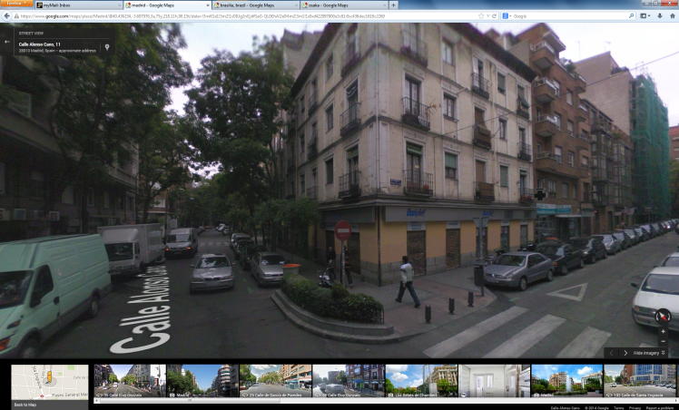
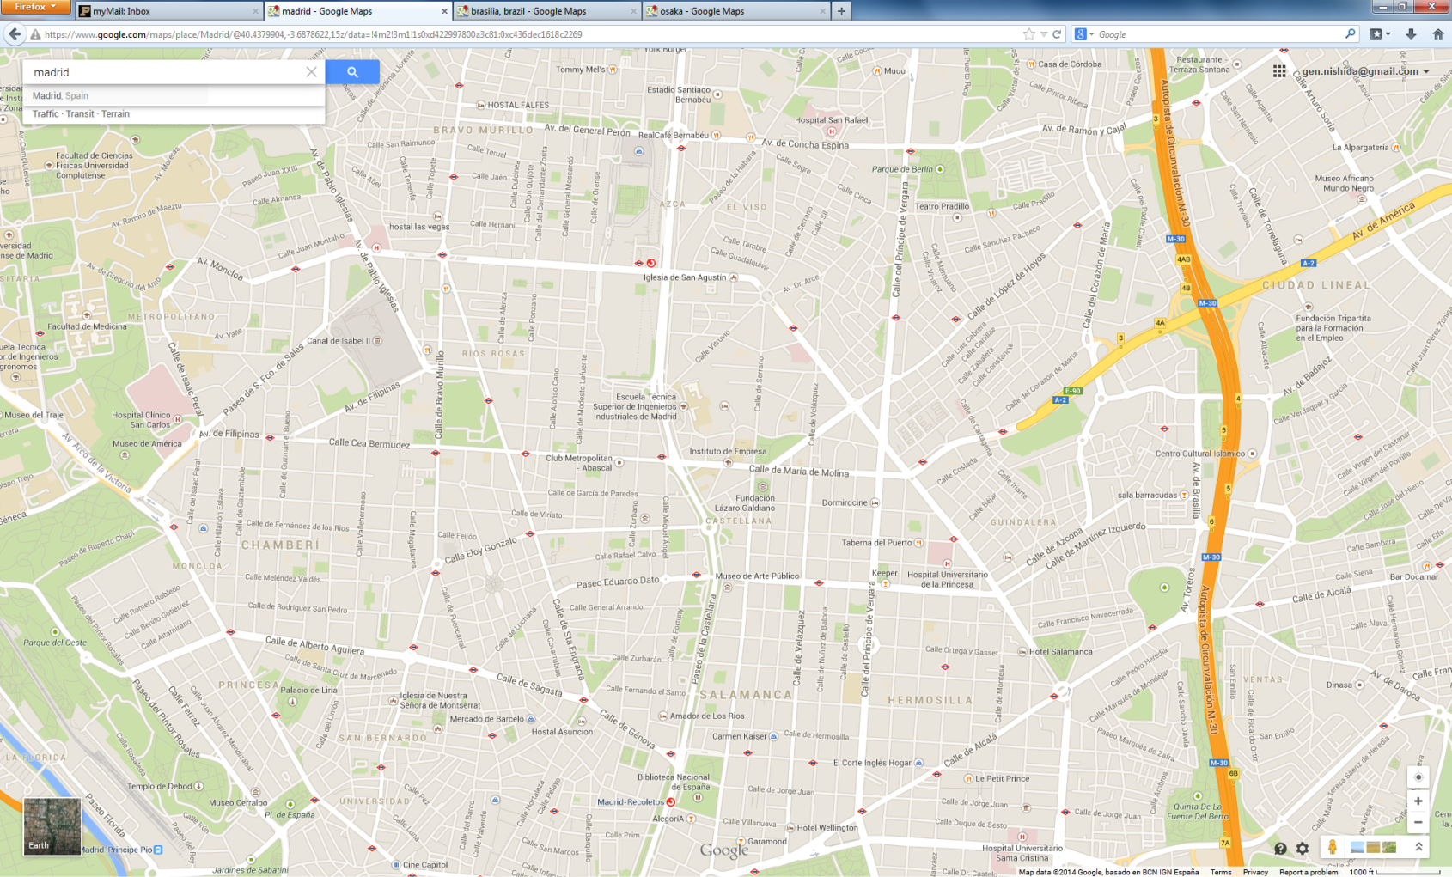
Madrid
Composite of commercial and residential area. The style of the local streets is similar to those in Tokyo, but the road segments are a little coarser.

Slide 11
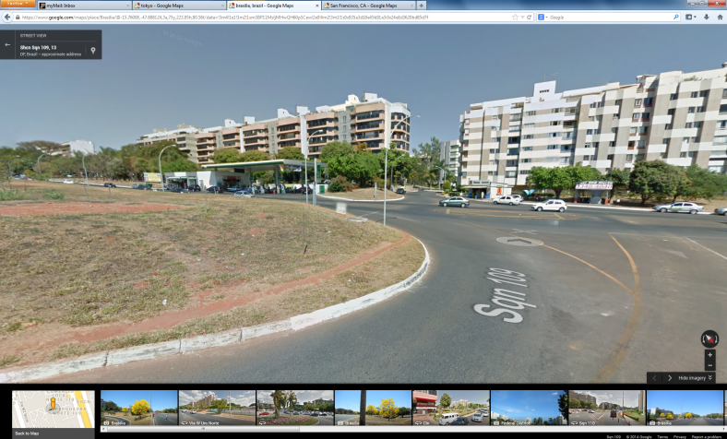
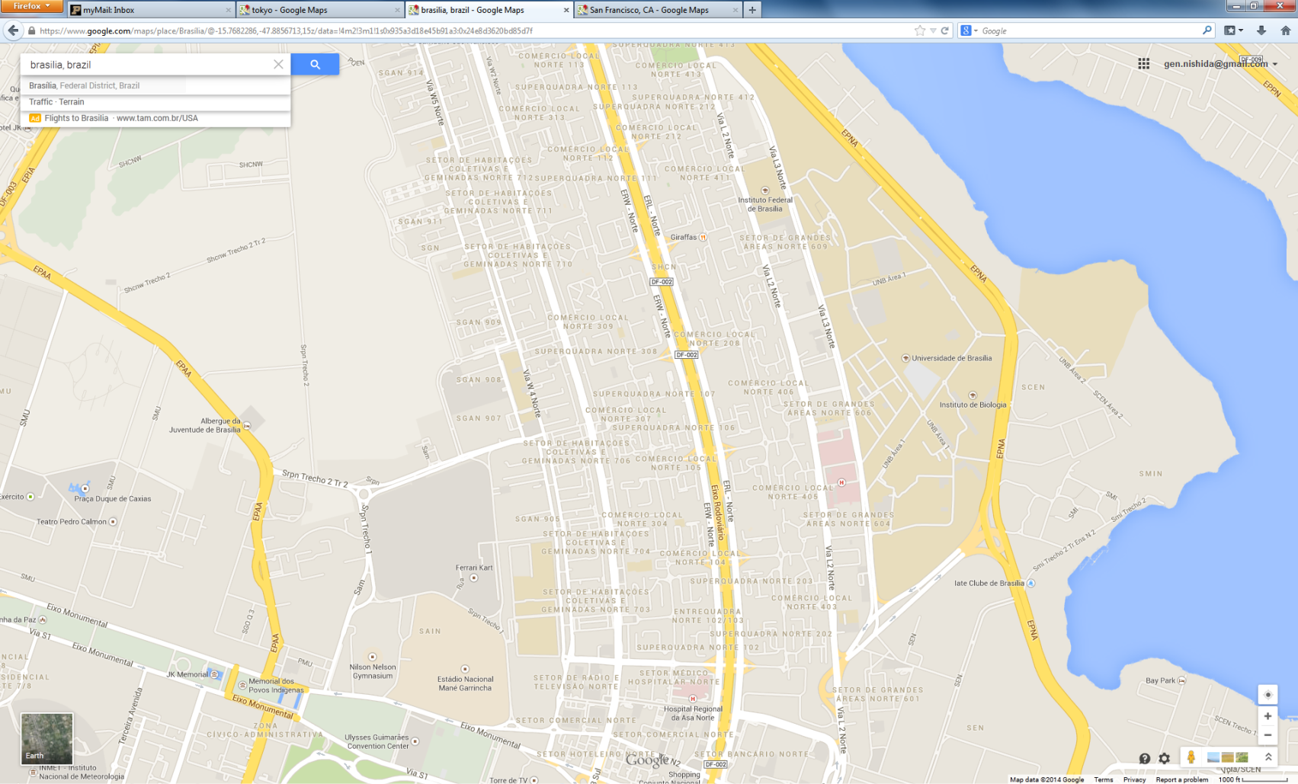
Brasilia
The residential area is surrounded by the commercial area. The design of the local streets is very interesting, but since the avenues are directional from North to South, it may be challenging to use this as an example.

